Slide 1





Mini Project Id: [Insert ID]
Clouderator
AI-Powered Cloud Infrastructure Operating System
PRESENTED BY:
SUPERVISED BY:
1. [Student 1 Name] - Roll No: [Roll 1]
[Supervisor Name]
2. [Student 2 Name] - Roll No: [Roll 2]
[Designation]
3. [Student 3 Name] - Roll No: [Roll 3]
ABES Institute of Technology, Ghaziabad
Affiliated to: DR. A.P.J. Abdul Kalam Technical University | Session 2026-27
Department of Computer Science & Engineering

Slide 2







Table of Content
01
Introduction
02
Objective
03
Literature Survey
04
Problem Statement
05
Proposed Solution
06
Mapping with SDGs Goals
07
References

Slide 3

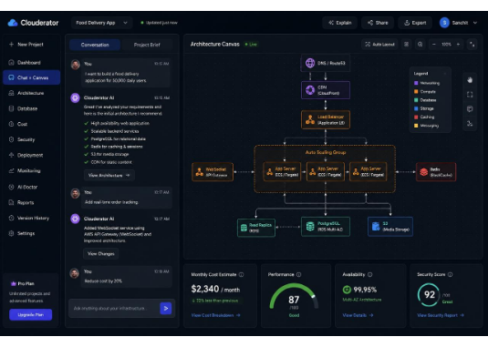
01. Introduction
Clouderator aims to simplify cloud infrastructure design and management by replacing traditional cloud consoles with an AI-powered, natural language interface.
Acts as a comprehensive AI Infrastructure Engineer.
Translates plain language into optimized architecture.
Generates deployment-ready Infrastructure as Code (IaC).
Monitors, troubleshoots, and optimizes seamlessly.

Slide 4









02. Objective
Natural Language First
Explainability by Design
Continuous AI Assistance
Abstracts the extreme complexity of cloud platforms, enabling users to design and deploy resilient architectures using intuitive conversational AI.
Provides complete transparency. Every architectural recommendation includes clear trade-offs, expected impacts, confidence scores, and reasoning.
Reduces the learning curve by offering end-to-end intelligent support—before, during, and after deployment, acting as an active DevOps partner.

Slide 5
03. Literature Survey
Traditional Cloud Management Requires deep domain expertise to manually configure complex networking, security, and scaling services, creating an enormous bottleneck and steep learning curve.
Infrastructure as Code (IaC) While frameworks like Terraform and CloudFormation bring essential automation, they strictly require specialized programming skills and extensive architectural knowledge.
AI in Cloud Operations Current AI tools assist primarily with basic code snippet generation but lack holistic, context-aware architectural understanding and end-to-end lifecycle management.
The Identified Gap There is a critical absence of integrated platforms that can autonomously design, logically explain, seamlessly deploy, and manage infrastructures purely from natural language.

Slide 6

04. Problem Statement
Users struggle with manual configuration of complex services like networking, databases, and security. This complexity leads to suboptimal architectures, security vulnerabilities, and uncontrolled costs, especially for startups and students. Clouderator abstracts this complexity away.

Slide 7
05. Proposed Solution (Methodology)
1. Requirement Analysis
User describes the application. The AI precisely analyzes infrastructure and database requirements.
3. Interactive Refinement
User modifies the architecture dynamically through chat (e.g., reduce costs, scale services).
2. AI Recommendation
4. Deployment & Ops
AI presents an optimized architecture along with comprehensive Cost and Security analyses and explanations.
Automatic IaC generation, cloud deployment, and continuous monitoring via the AI Infrastructure Doctor.

Slide 8









06. Mapping with SDGs Goals
SDG 9: Industry & Innovation
SDG 8: Economic Growth
SDG 4: Quality Education
Empowers startups and small businesses by drastically reducing IT overhead and infrastructure costs, fostering productive employment.
Significantly reduces the technical learning curve for students and junior developers through highly explainable AI architectures.
Promotes inclusive and sustainable industrialization by democratizing access to resilient, automated, and intelligent cloud infrastructures.

Slide 9
07. References
Clouderator Project Summary Core internal document defining the project vision, major modules, workflow, and long-term trajectory for the AI Infrastructure Operating System.
Academic Literature Singh, V. K., Awasthi, P., Tripathi, L., Thakur, S., & Singh, P. (2024, August). Mern Stack Web-Based Streaming and Broadcasting Application. In 2024 International Conference on Electrical Electronics and Computing Technologies (ICEECT) (Vol. 1, pp. 1-6). IEEE.
Industry Standards & Guidelines Official documentation and best practice frameworks on cloud architecture, Infrastructure as Code (IaC) standards, and DevOps methodologies.

Slide 10
Thank You!
Are there any questions?

Slide 11

Image Sources
https://postperspective.com/wp-content/uploads/2026/07/felipe-01.jpg
Source: postperspective.com

